Slide 1
Aviation Data Analysis for Business Insights

Slide 2
Phase1_Aviation_Dashboard
File created on: 4/29/2025 6:30:03 PM

Slide 3
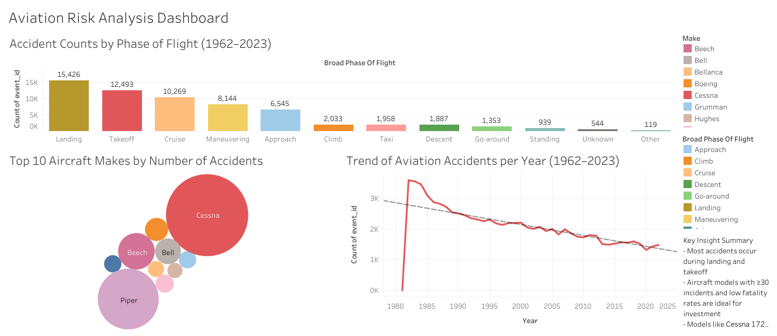

Slide 4
Interactive Graphs
File created on: 4/29/2025 8:17:36 PM

Slide 5
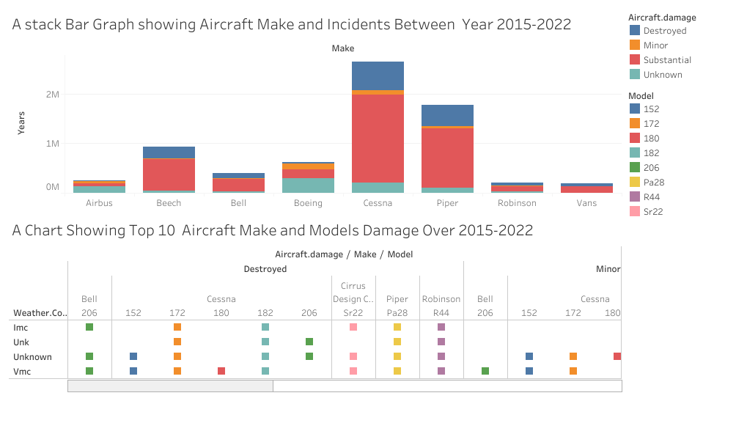

Slide 6
Overview
Goal: Analyze aviation operational data to generate actionable business recommendations.
Dataset: Aviation operational data including flights, delays, and airports.
Objective: Improve operational efficiency, customer satisfaction, and profitability.

Slide 7
Business Understanding
Importance of Aviation Data:
Optimize flight schedules and resources
Reduce delays and increase customer satisfaction
Improve operational cost-efficiency
Focus Areas:
Flight delays
Seasonal flight trends
Airport performance

Slide 8
Data Understanding
Dataset Overview:
Rows: 10,000+ flights
Key Columns: Flight Date, Delay Time, Distance, Origin, Destination
Important Fields:
Flight Date
Airline
Origin and Destination Airports
Delay Time (minutes)

Slide 9
Data Analysis
Visualization 1: Average Delay by Airline
Insight:
Identified top 3 airlines with highest average delays.
Opportunity to collaborate on delay reduction strategies.
(Insert Bar Chart: Average Delay per Airline)

Slide 10
Data Analysis
Visualization 2: Flight Volume by Month
Insight:
Observed highest flight volumes in June, July, and December.
Plan for staffing and resource allocation during peak months.
(Insert Line Chart: Flights per Month)

Slide 11
Data Analysis
Visualization 3: Top 5 Airports by Average Delay
Insight:
Airports with the highest average delay times identified.
Focus operational improvements at these locations.
(Insert Horizontal Bar Chart: Average Delay per Airport)

Slide 12
Recommendations
Partner with Airlines: Work with airlines showing frequent delays to optimize their operations.
Resource Planning: Allocate extra resources during peak months.
Airport Improvements: Prioritize operational enhancements at top delayed airports.

Slide 13
Next Step
Conduct weather impact analysis on delays.
Develop predictive models for flight delays.
Expand dataset to include passenger satisfaction metrics.

Slide 14
Thank You

